Slide 1
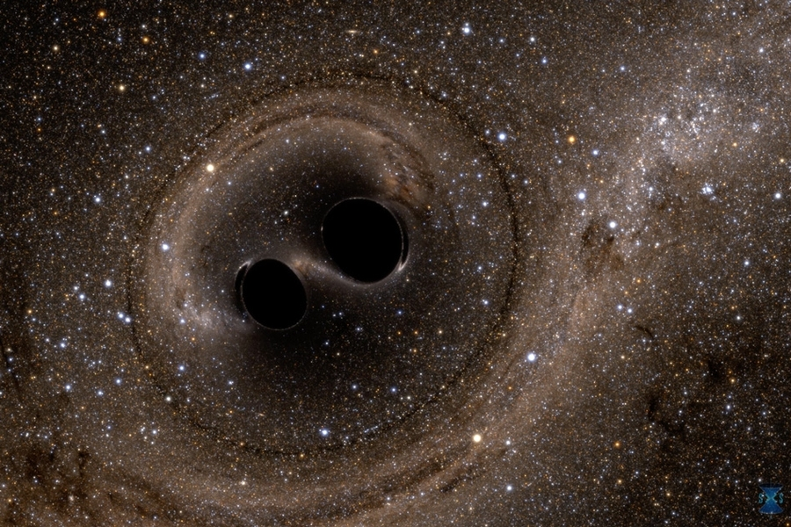

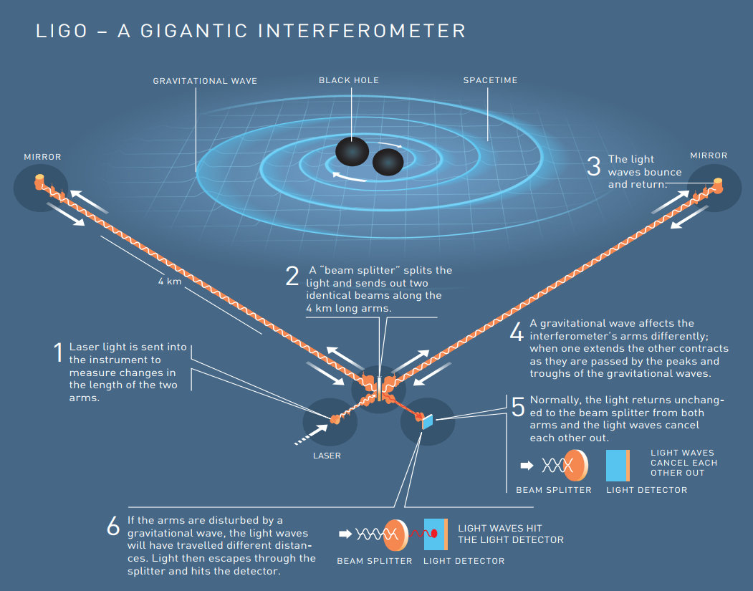
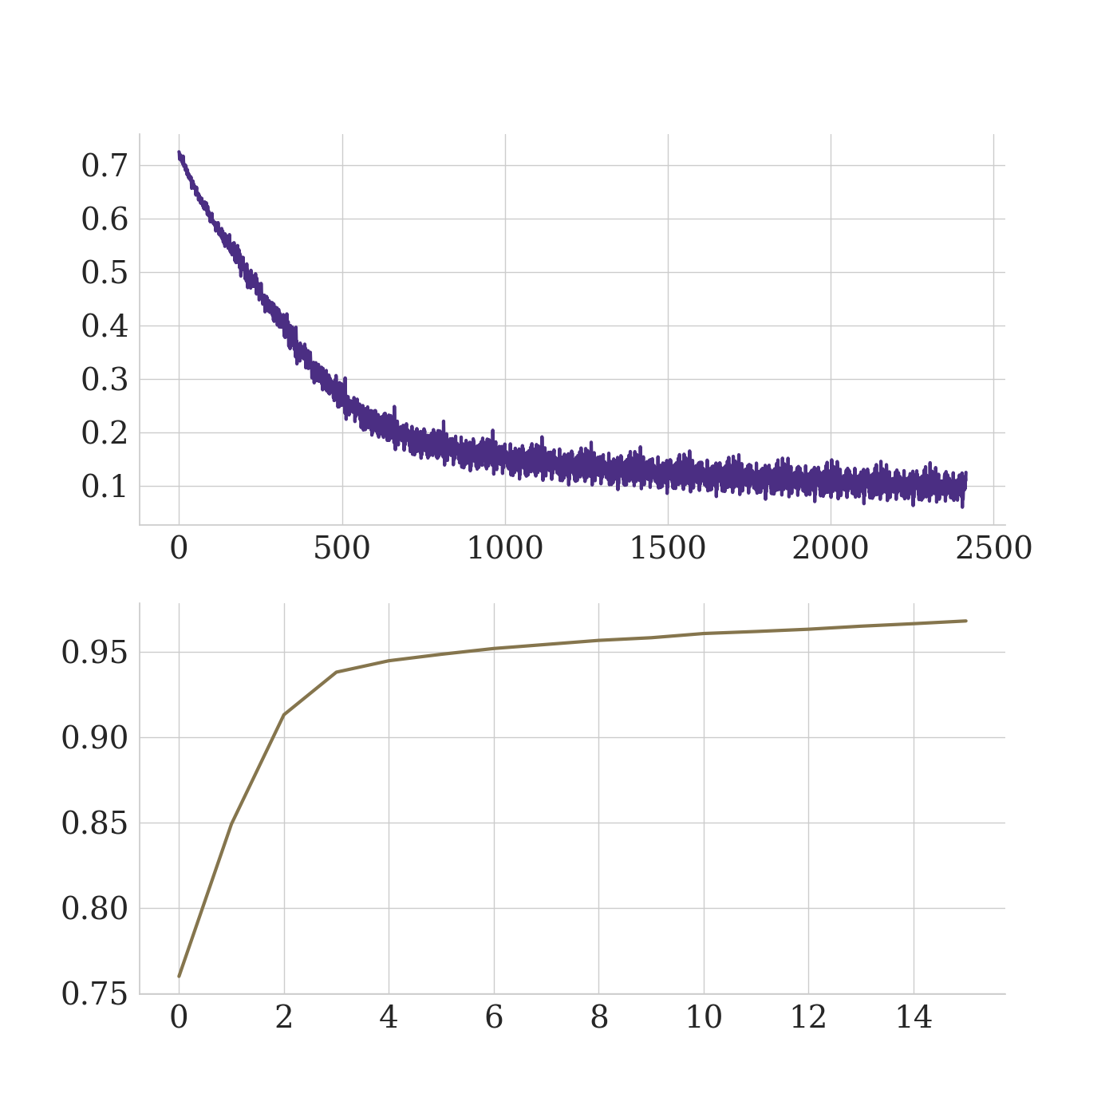
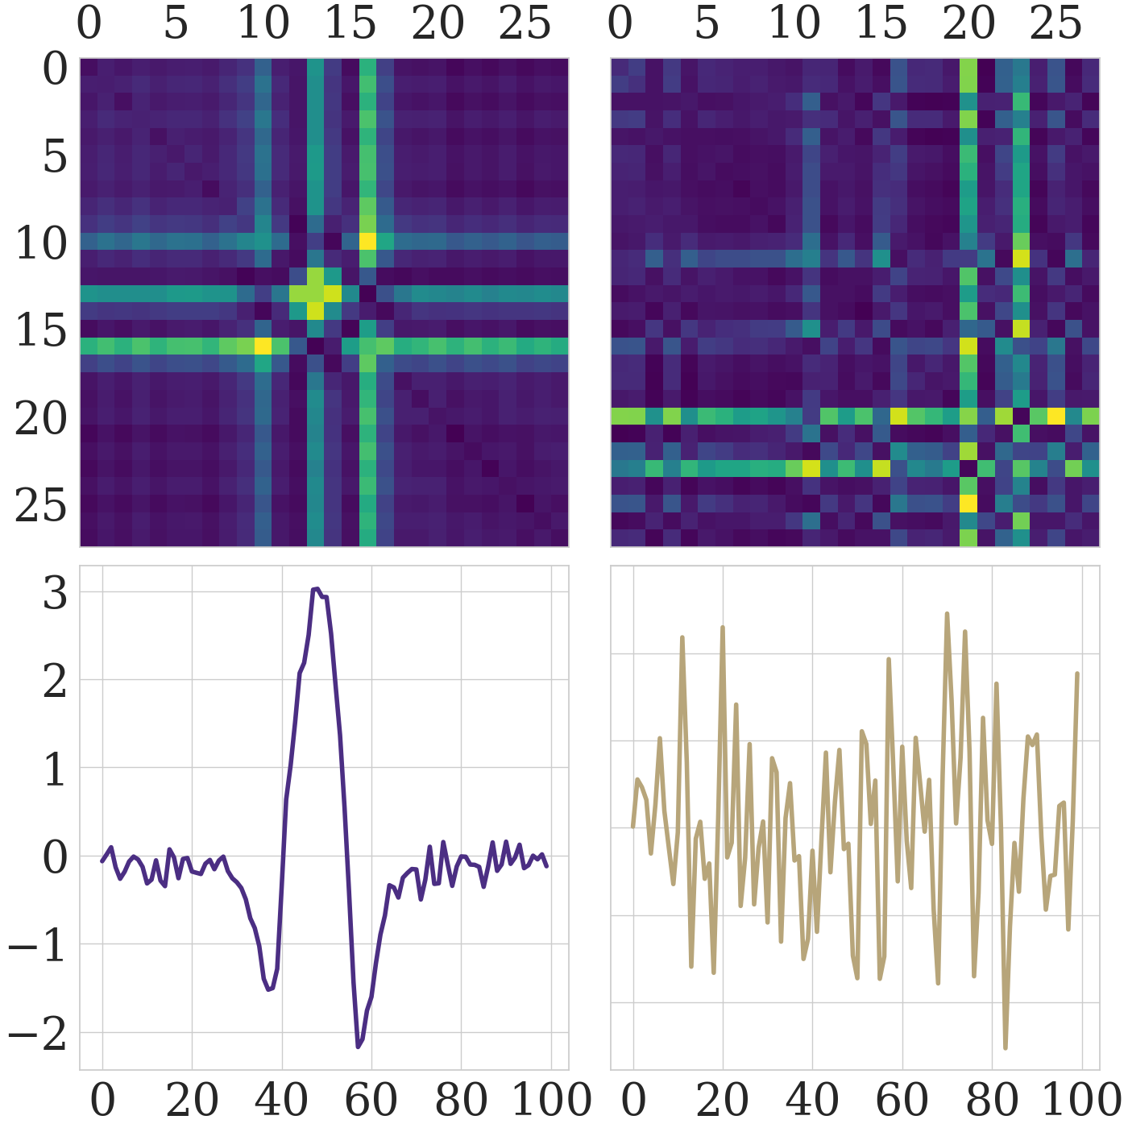
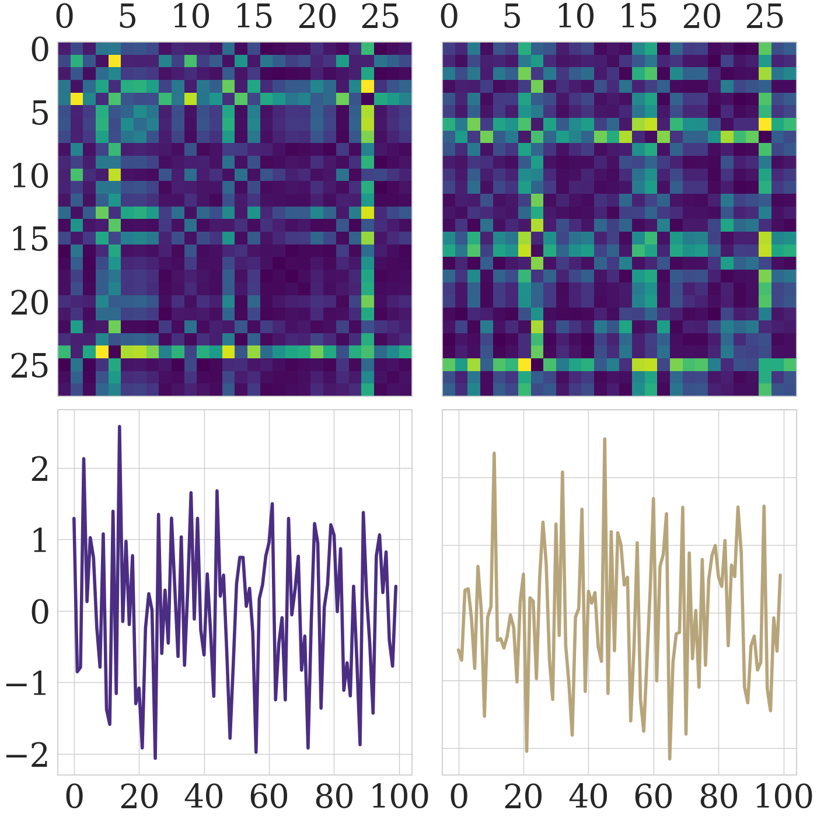
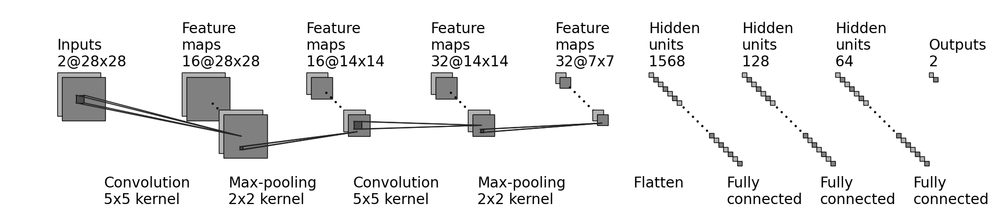
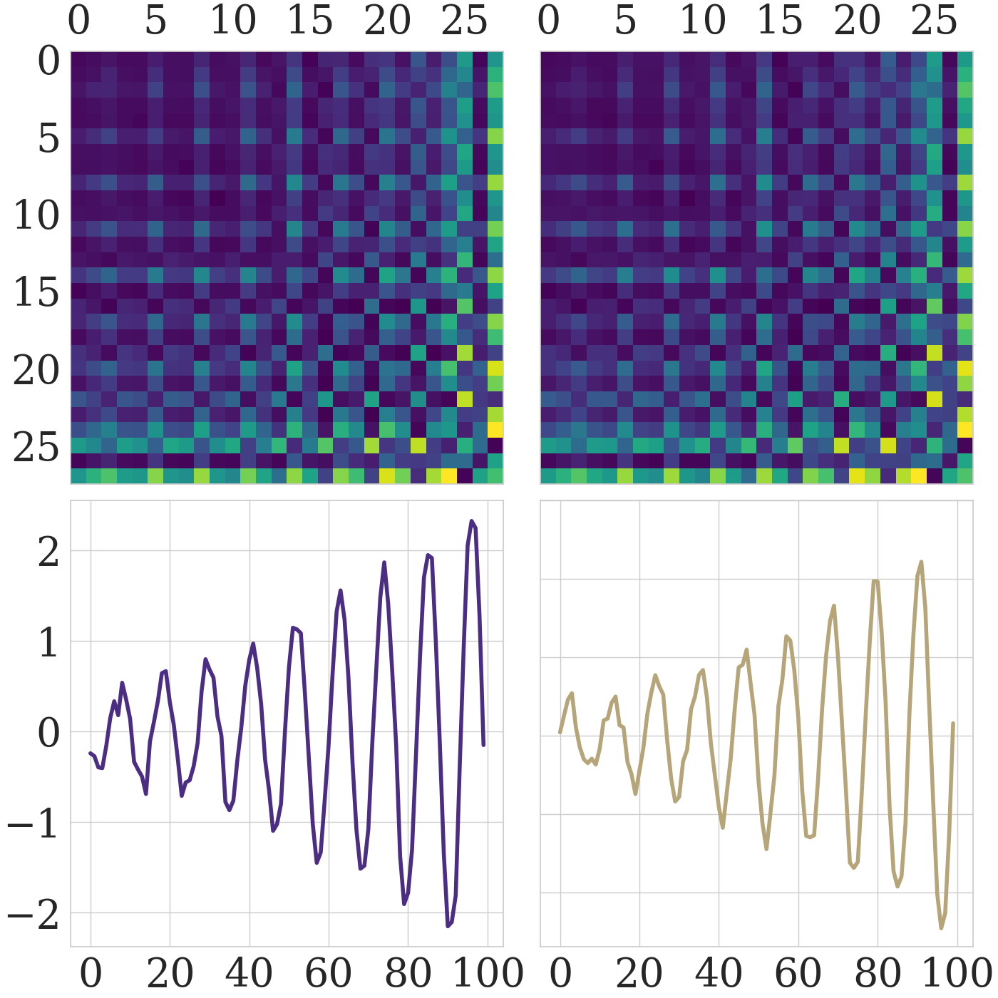
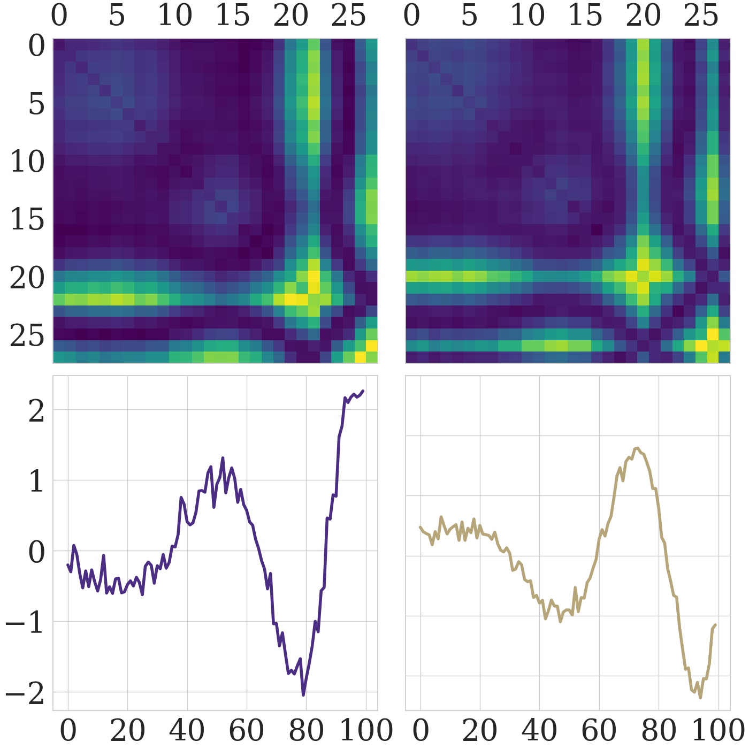
UNRAVELING GRAVITATIONAL RIPPLES: NEURAL NETWORK CLASSIFICATION
Hanford
Livingston
Daniel Fredin¹, Cole Welch¹
¹Department of Physics, University of Washington
Artist’s rendition of binary black hole merger.
Physics 417 Symposium @ eScience Institute
June 1, 2023
INTRODUCTION
Quick Facts About Our CNN
> ~ 97% testing accuracy
> Data split of 70% training, 15% validation, and 15% testing
> Dataset contains a total of 146045 gravitational wave time series
> Applied Gramian Angular Summation Field (GASF) algorithms to encode gravitational wave data as 2D images for classification
> Neural network consisted of 2 convolutional / pooling layers followed by 3 fully connected layers and an output
> Utilized a cross-entropy loss function with an Adam optimizer
> Utilized batch normalization and ReLU activation functions along with L2 Regularization
RESULTS
Dataset source: Glitch dataset originates from the Laser Interferometer Gravitational-Wave Observatory (LIGO) in Hanford, WA, and Livingston, LA.
LIGO observatory: Designed to identify and understand the sources of gravitational waves using light and space characteristics.
Dataset categories: Consists of four distinct data categories - Glitch, Background, Binary Black Hole (BBH), and Sine-Gaussian (SG).
Objective: Develop a binary classifier to identify signals as either Glitch/Background or Binary Black Hole/Sine-Gaussian.
Model performance: Training loss of about 0.1 and validation accuracy near 96% after 16 epochs and over 2400 iterations.
Testing accuracy: CNN model achieved a respectable accuracy of 97% on the testing dataset.
Comparison with literature: Similar CNN architectures in the literature achieved higher accuracies, such as 99% (Fernandes et al., 2018) and 98.8% (George D. et al., 2023).
Dataset differences: Our dataset consisted of separate time series for gravitational wave signal data and noise data, while other works had to apply more complex noise filtering methods.
Image conversion: Gramian Angular Summation Fields were effective for image conversion in our case, while others found Fourier transforms more suitable for handling complex noise and background through frequency domain filtering.
DATA ANALYSIS
Training Loss and Validation Accuracy
Scaling: Utilized the StandardScaler function to ensure data was normalized before conversion to GASF images.
Model output: Probability predictions of images for background or signal compared to ground truth targets with Softmax function.
Testing and accuracy: Tested trained model against a separate testing dataset, achieved an overall accuracy of 97%.
Misclassification patterns: Model tends to misclassify when detectors have conflicting data.
Example misclassification: In the sample of glitch data below, the model misclassified the GASF image as a signal, despite the Hanford signal being a glitch and Livingston signal being background noise.
Possible flaws: Confusion may arise from contradictory signals between detectors or flaws in observatory data capture.
Training Loss
Basic layout of the LIGO interferometer.
METHODOLOGY
Iterations
Problem: Implementing a binary classifier using PyTorch for time series data.
Conversion: Convert time series data to 2D images using Gramian Angular Summation Fields (GASFs) with pyts library.
Image size: GASF images are 28x28 pixels for a balance between performance and accuracy.
Data splitting: Split data into training (70%, 102227 images), testing (15%, 21910 images), and validation (15%, 21908 images) sets.
CNN architecture:
Convolution layers: Two convolution layers with 2 input channels, 16 output channels, kernel size 5, stride length 1, and padding 2; and 16 input channels, 32 output channels, kernel size 5, stride length 1, and padding 2.
Max pooling layers: Applied after each convolution layer with kernel size 2, stride 2, and padding 0.
Fully connected layers: Three subsequent linear layers with dimensions 1568x128, 128x64, and 64x2, respectively.
Training: Trained for 16 epochs, learning rate of 5e-6, batch size of 677, L2 regularization with coefficient 0.001.
Loss function and optimizer: Cross-entropy loss function and Adam optimizer.
Validation Accuracy
Epochs
Top: The CNN’s training loss as a function of iterations.
Bottom: The CNN’s validation accuracy as a function of epochs elapsed.
Glitch
Background
CONCLUSION
Hanford
Livingston
Hanford
Livingston
Pixels
Pixels
Pixels
Pixels
Objective: Analyzing the potential of CNNs for classifying gravitational waves strain data as background noise/glitches or transient sine-gaussian/binary mergers.
Approach: Utilized a simplified version of common approaches in the literature.
Performance: Surpassed expectations by achieving an accuracy of 97%.
Comparison: Achieved accuracy slightly below more complex CNNs used for comparison.
Further exploration: Investigating the effectiveness of the Gramian Angular Summation Field approach for converting time series to images and passing them through a simple CNN on more realistic data.
Pixels
Pixels
Strain
Strain
Time (s)
Time (s)
Time (s)
Time (s)
Sine-Gaussian
Binary Black Hole
Hanford
Livingston
Hanford
Livingston
Pixels
Pixels
Pixels
Pixels
REFERENCES
Basic structure of our CNN.
Pixels
Pixels
Gramian Angular Summation Fields
[1] Z. Wang and T. Oates. Encoding Time Series as Images for Visual Inspection and Classification Using Tiled Convolutional Neural Networks. In The Twenty-Ninth AAAI Conference on Artificial Intelligence. (AAAI), January 2015.
[2] T. S. Fernandes, et al. Convolutional Neural Networks for the classification of glitches in gravitational-wave data streams, arXiv:2303.13917v1 [gr-qc], March 2023.
[3] D. George, H. Shen, and E. A. Heurta. Glitch Classification and Clustering for LIGO with Deep Transfer Learning. Phys Rev. D, 97:101501, May 2018.
Definition: Method for visualizing time series data in a two-dimensional image format.
Conversion: Converts time series into a symmetric matrix which represents the pairwise angles between points in the time series.
Application: Provides visual representation of complex temporal patterns which is useful for tasks like classification of time series data.
Strain
Strain
Time (s)
Time (s)
Time (s)
Time (s)
Sample of the four signal categories from the time series data and their corresponding GASF images from both the Hanford and Livingston detectors.

